Slide 1
Rain Prediction
CAI3101 – Introduction to Artificial Intelligence
1

Slide 2
Supervisions
Dr Mohamed Hamouda
ENG. Mohamed Moheb
2
2

Slide 3
Prepared by:
Mahmoud Samer 231006523
Rawan Atef 231005789
Retaj Ali 231005689
Youstina Mamdouh 231014763

Slide 4
Introduction
Weather prediction is an important real-world problem that affects daily life, agriculture, and transportation.
In this project, machine learning techniques are used to analyze historical weather data and predict rainfall.
The project demonstrates the complete machine learning workflow, starting from data preprocessing to model evaluation and prediction.
4

Slide 5
Description
The goal of this project is to build a machine learning system that predicts:
RainToday
RainTomorrow
Using historical weather features such as temperature, humidity, wind, and location.
Multiple machine learning models are trained and compared to select the best-performing model
5

Slide 6
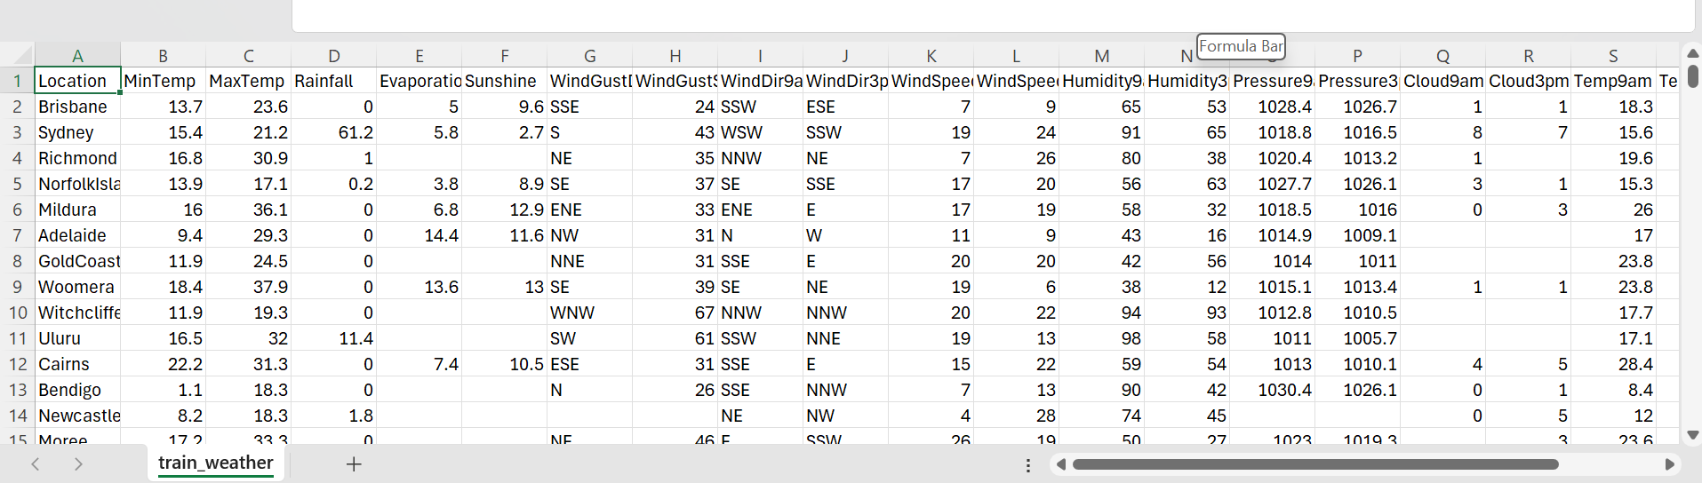
Dataset Description
Dataset Source: Public weather dataset (CSV file)
File name: train_weather.csv
Number of samples: More than 200
Number of features: Multiple
numerical and categorical features
Target variables:
RainToday (Binary Classification)
RainTomorrow (Binary Classification)
6

Slide 7
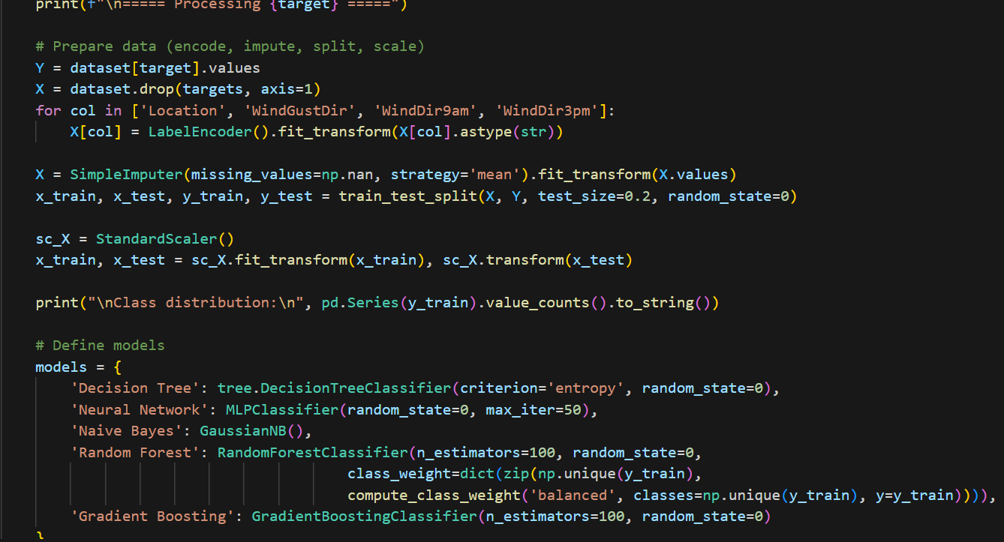
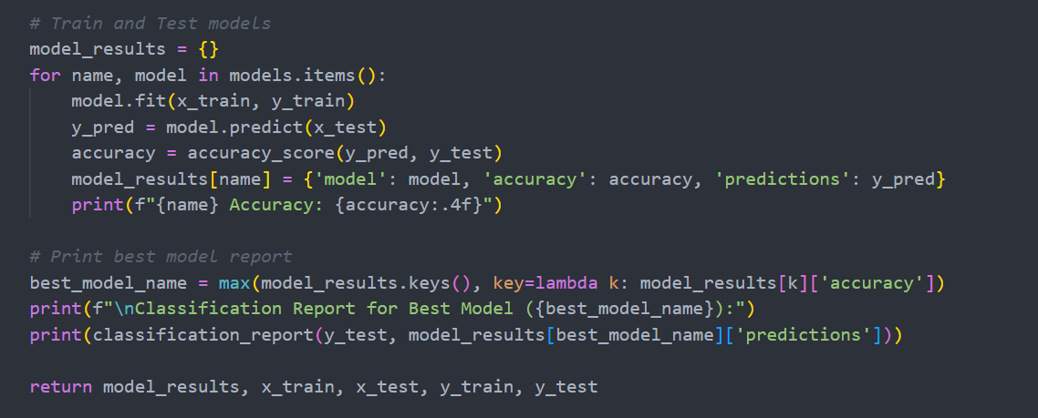
Data Preprocessing
The goal of this project is to build a machine learning
The following preprocessing steps were applied:
These steps ensure better model performance and fairness.
Handling missing values using mean imputation
Encoding categorical variables using Label Encoding
Feature scaling using StandardScaler
Splitting data into:
80% Training
20% Testing
7

Slide 8
Machine Learning Models Used
The following models were trained and tested:
Decision Tree Classifier
Naive Bayes (Gaussian)
Artificial Neural Network (MLP)
Random Forest
Gradient Boosting

Slide 9
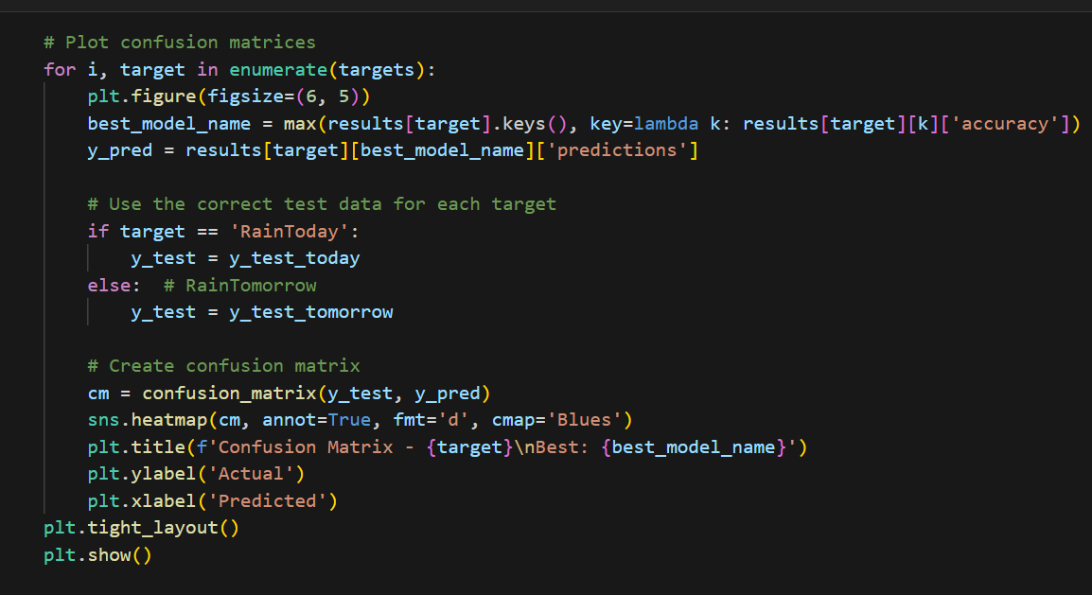
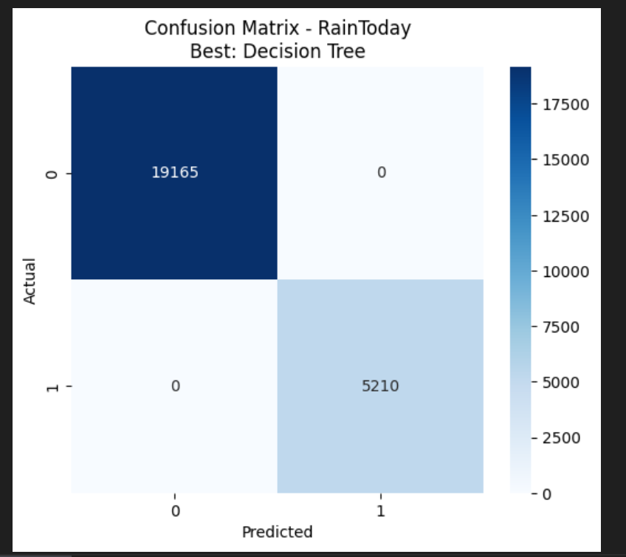
Confusion matrices
9

Slide 10
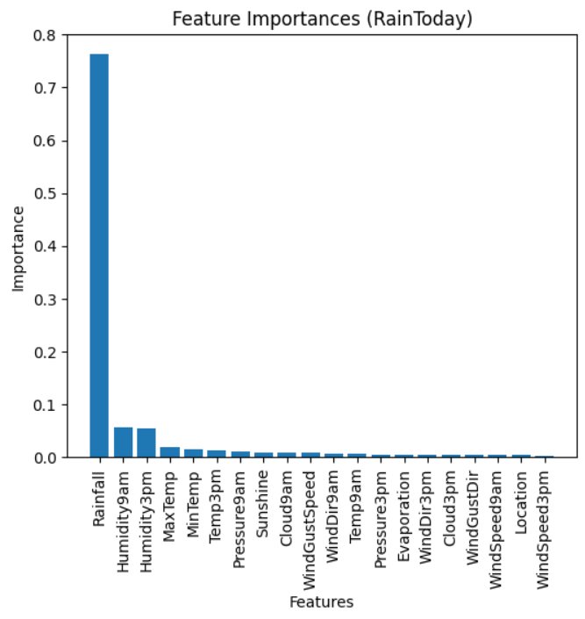
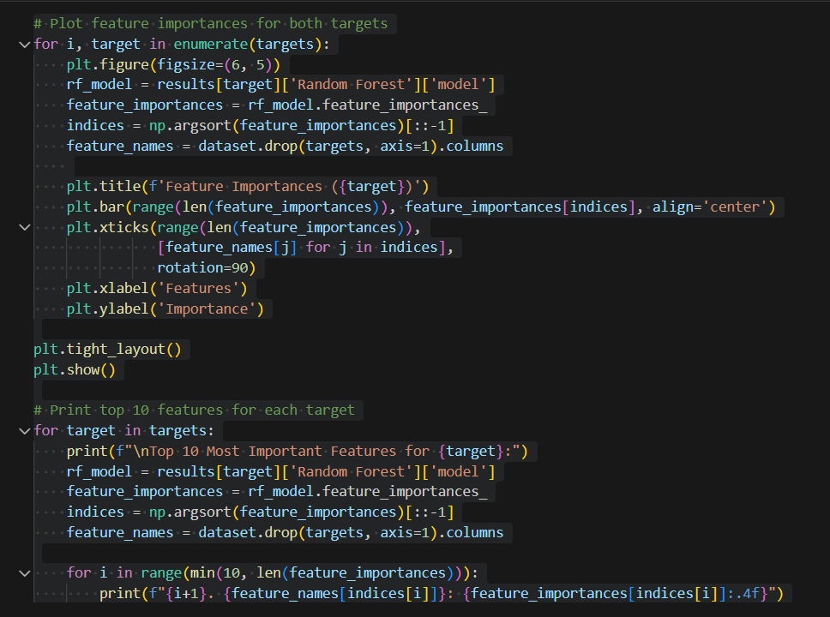
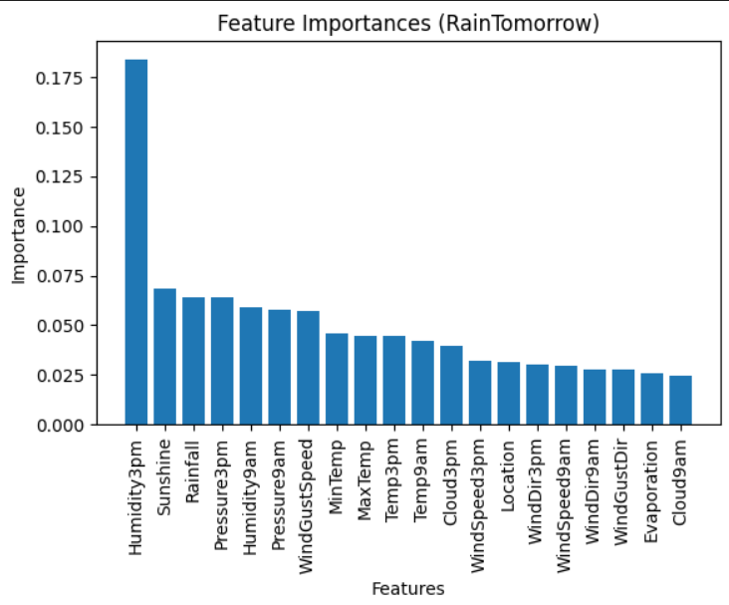
FEATURE Importance Analysis
10

Slide 11
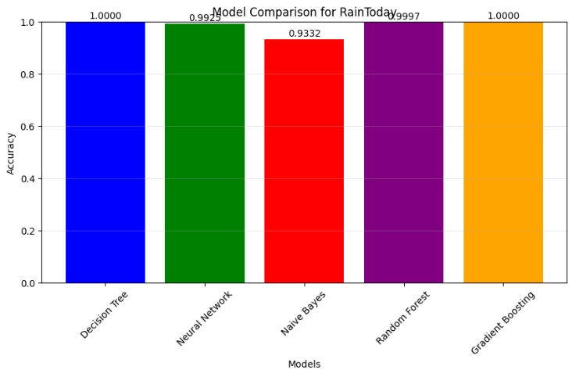
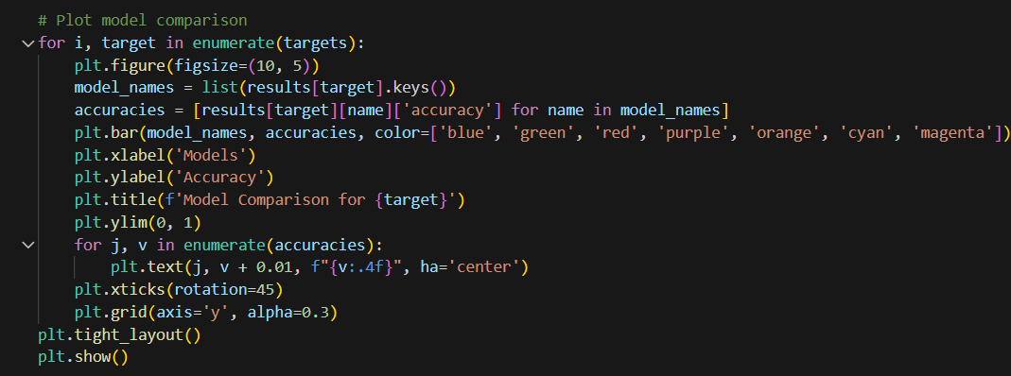
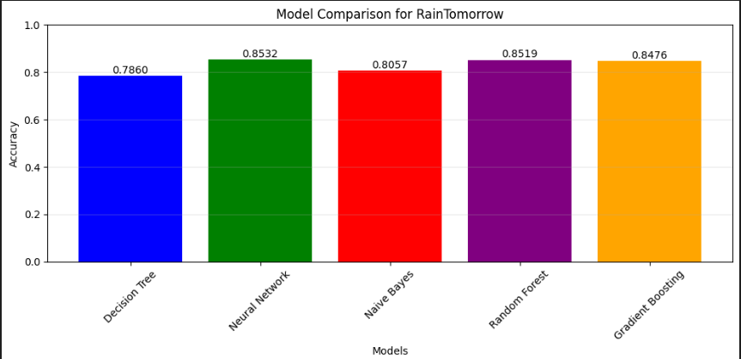
Model Comparison
Accuracy comparison between all models was visualized using bar charts.
This helped in:
Identifying the best-performing
model
Understanding strengths and
weaknesses of each model
11

Slide 12
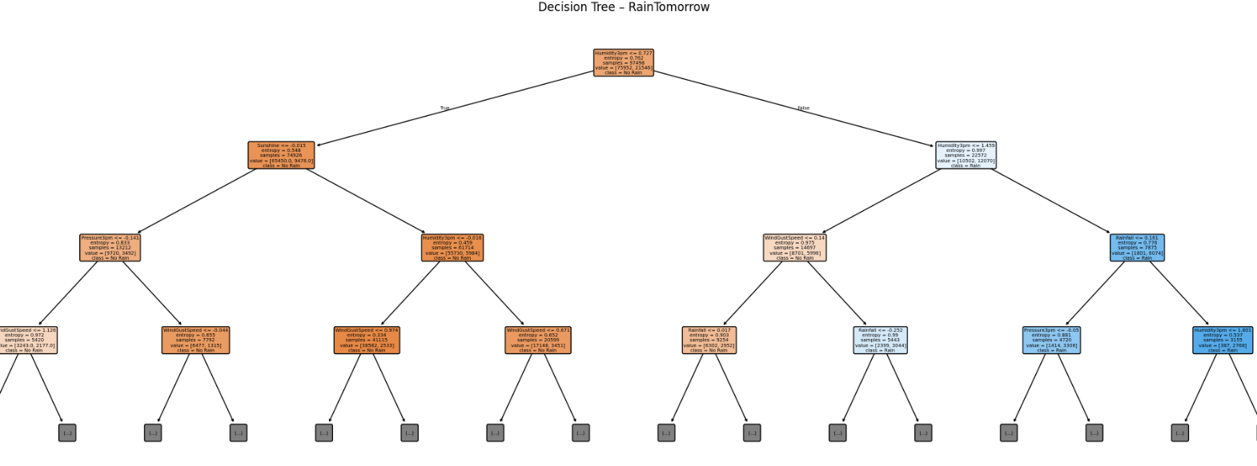
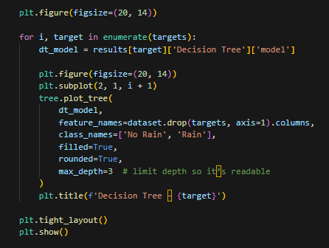
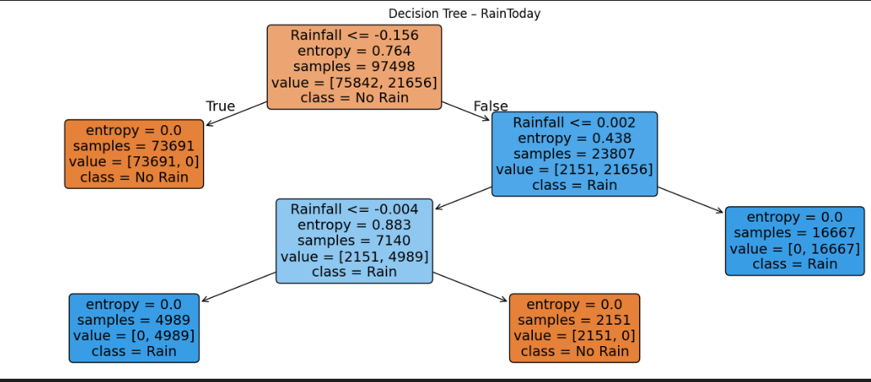
Decision Tree Visualization
Decision Trees were visualized to:
Understand decision-making logic
Interpret model behavior
The depth was limited to keep the tree readable
12

Slide 13
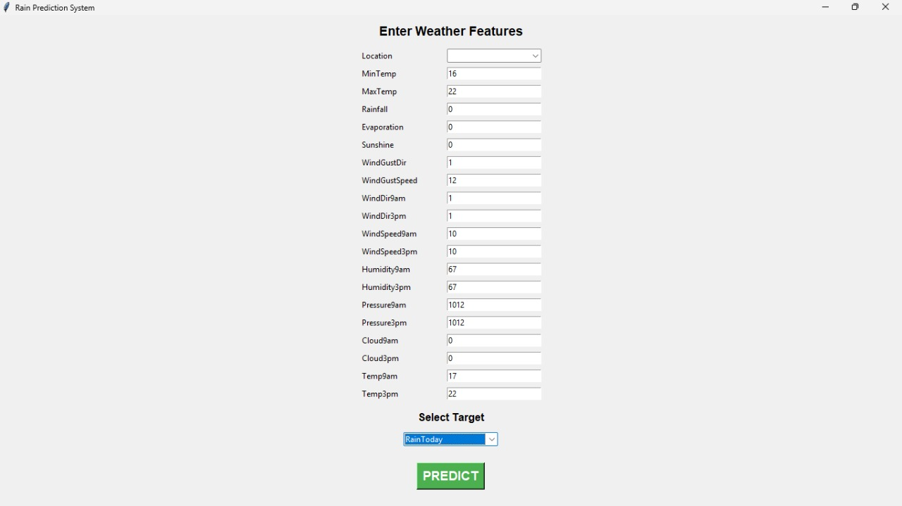
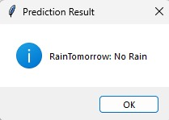
GUI
13

Slide 14
THANK YOU

